Slide 1
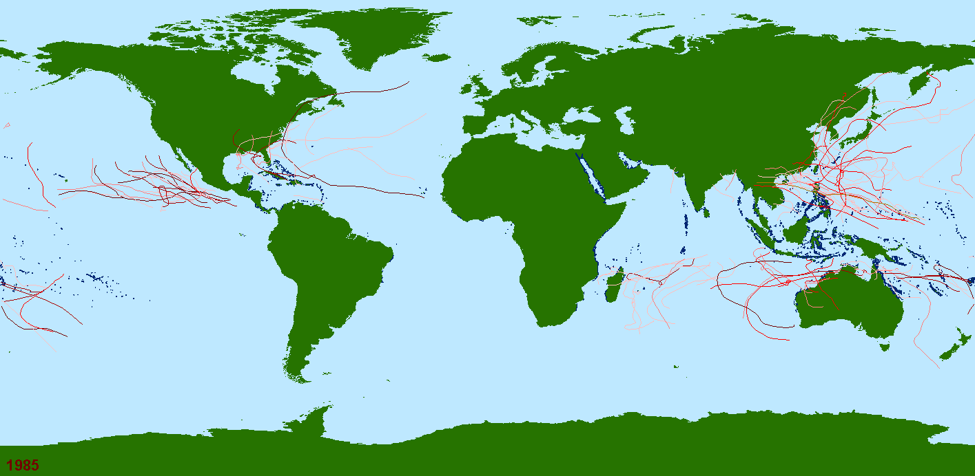


Modelling tropical cyclone (TC) impacts on the world’s coral reefs
Tropical cyclones, 1985-2009 (n = 2,261)
Sea
Land
Reef
Tropical storm Tropical cyclone Hurricane
Dr. Marji Puotinen and Adam Carrigan

Slide 2
Many reefs repeatedly exposed to TCs
Mean annual TC days
Carrigan and Puotinen, 2011, Geophysical Research Letters.
1985-2009
Reefs in the GBR are typically exposed to <5 TC days per year.
0
(gale force+ winds)
28
Coral reef

Slide 3
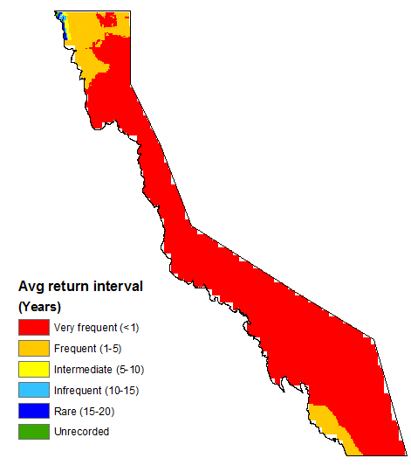
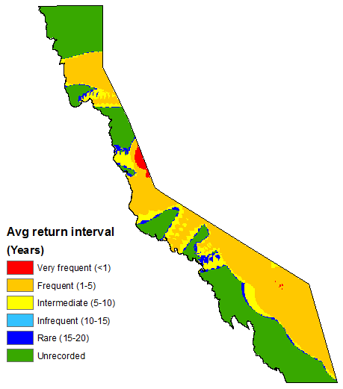
% reef area affected
Severe TC Winds (33 m/s) - Return interval
% reef area affected
n=46 TCs, 1985-2011
n=46 TCs, 1985-2011
Gale Force Winds (17 m/s) – Return interval
Notes:
Tropical cyclones, such as Justin [hit animation], which passed through the Great Barrier Reef in 1997, and Ivor, [hit animation] which passed through in 1990 generate unusually large waves that can cause signficant structural damage to coral reef communities...

Slide 4
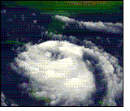
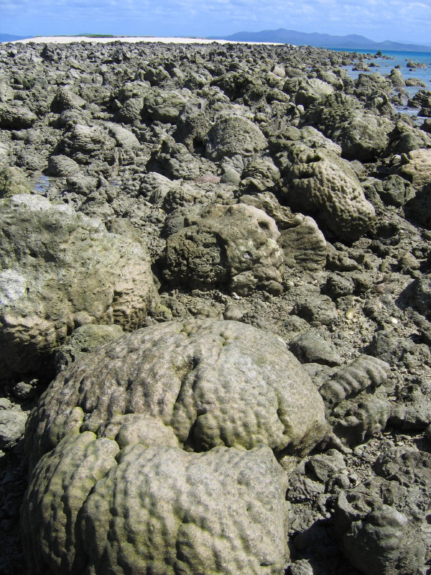
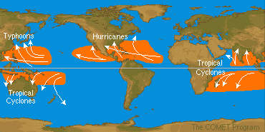
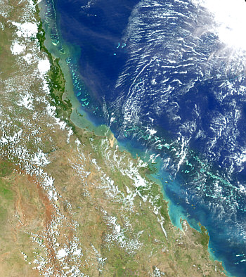
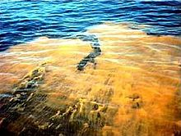
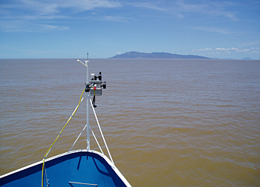
TCs can damage coral reefs, but...
Large waves
Heavy rain
Waves break on reefs
Flood plume extends onto reefs
Phytoplankton blooms
Impacts = dislodgement of massives, breakage, sand burial, stripping, loss of reef framework, etc.
Impacts = lowered salinity, reduced light, sediment deposition
Impacts = Smothering

Slide 5
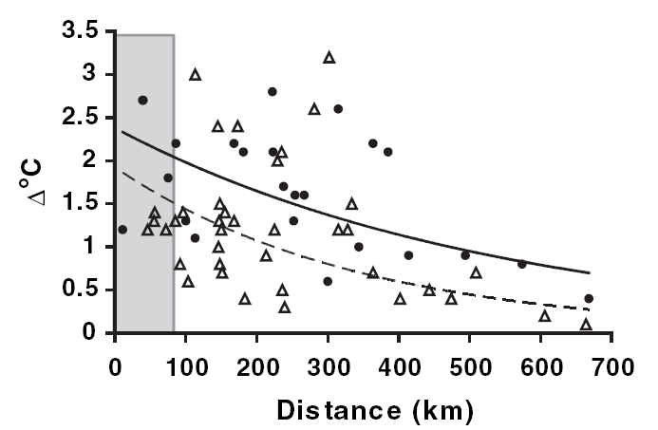
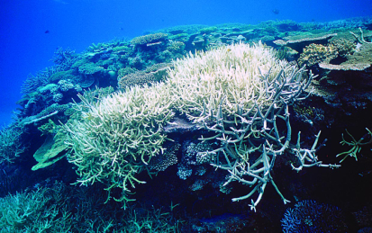
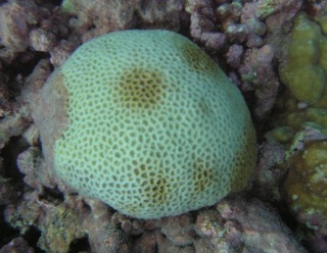
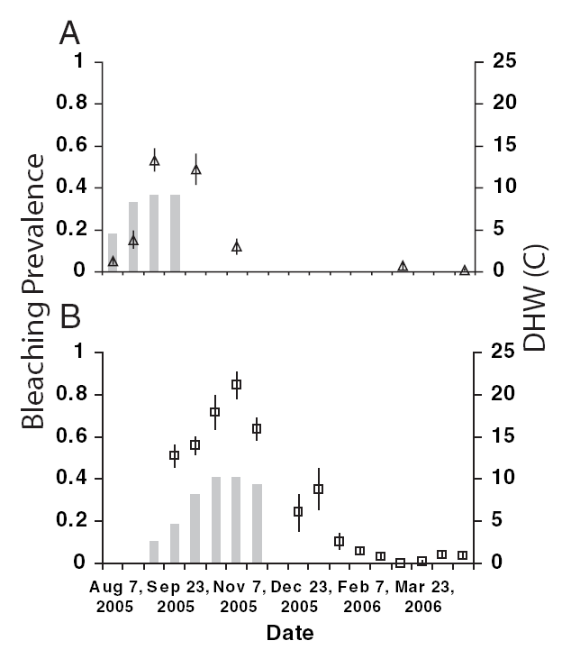
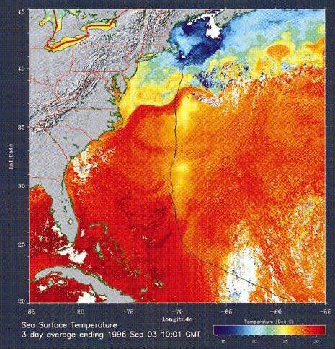
…can also protect reefs from high SST.
TC wave damage zone
TC winds can lower SST up to 10º C for days to weeks.
Potential cooling zone
Cyclone track
Cooling zone
TCs
Florida
Reef
Tract:
4 TCs
Manzello et al 2007
“Manzello Effect” – A TC that passes within 400 km of a reef under thermal stress may reduce both the extent of bleaching and recovery time.
US
Virgin
Islands:
0 TCs
Monaldo et al 1997
Manzello et al 2007

Slide 6
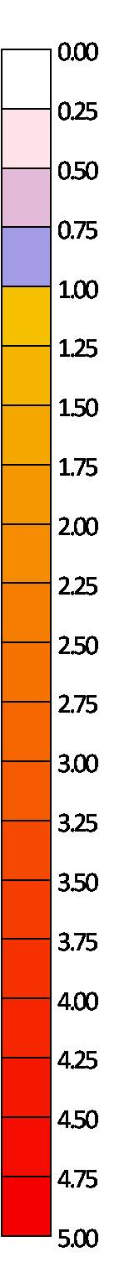
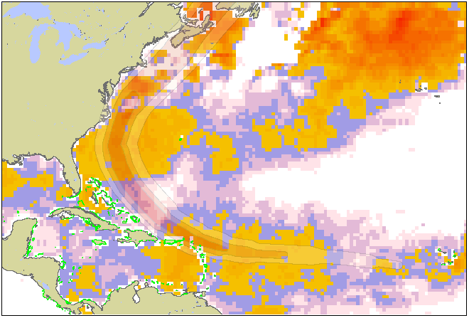
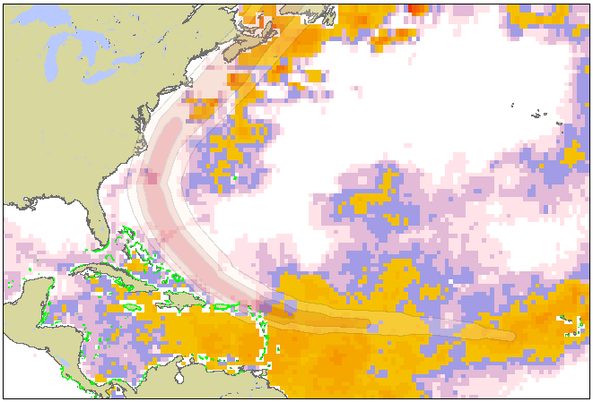
TC Earl (2010) erases coral bleaching risk
2-week pre-TC hotspots
(August 12 - 23)
Bleaching risk
2-week post-TC hotspots
(September 6 – 20)
Notes:
Once Earl became hurricane, all hotspots were erased. Earl was just part of the story, however, as Danielle et al followed similar North Atlantic trajectories. Florida reef tract and Northern Caribbean reaped the biggest benefits off Earl. Discussion on hotspots, DHW and how what role hurricanes might have played in 2010…comment on spread of cool wakes beyond radius of gales (see florida reefs following Earl), how currents may be involved, etc. Curious to see 2010 bleaching reports…

Slide 7
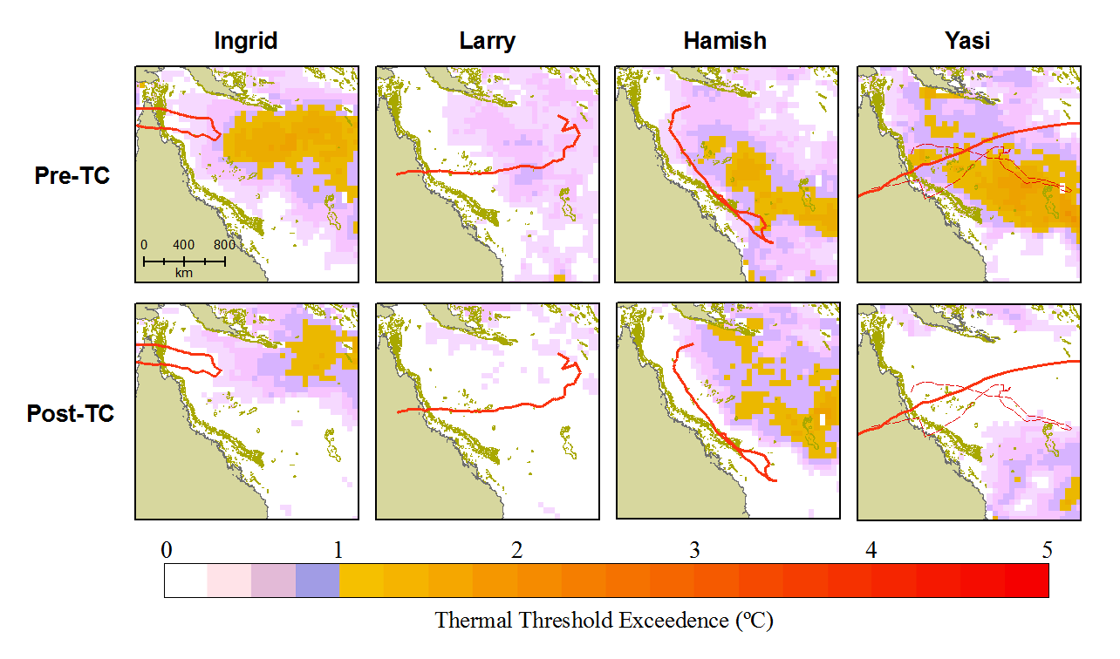
2005 2006 2009 2011
Hotspot
Hotspot
This can:
Reduce stress below critical threshold
Reduce accumulation of stress / season.

Slide 8
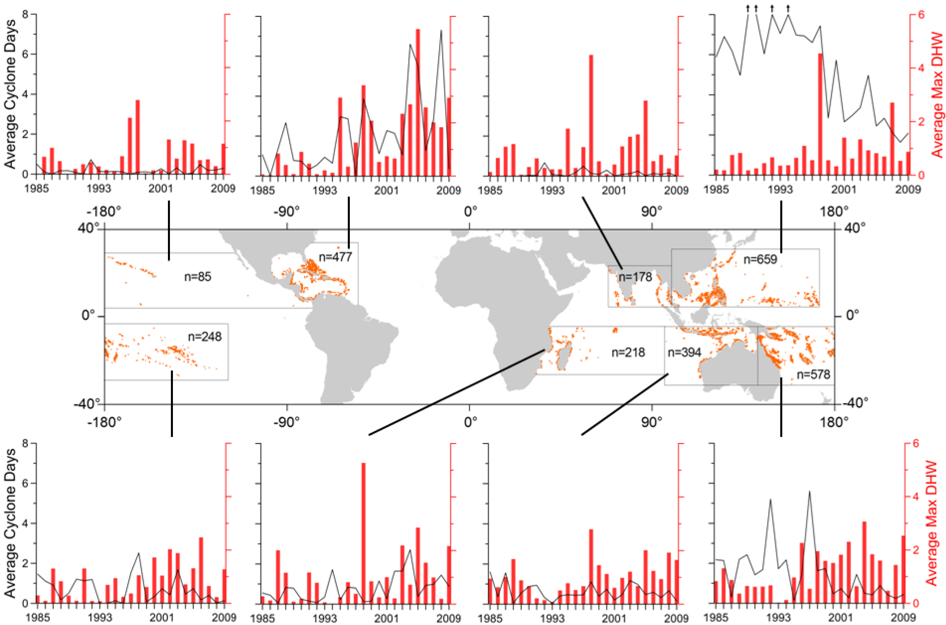
Does this happen enough to be useful?
Carrigan and Puotinen, 2011, Geophysical Research Letters
Mean max thermal stress (DHW)
Mean # of TC days
Coral reef
Frequent TCs & high thermal stress = potential for interaction

Slide 9
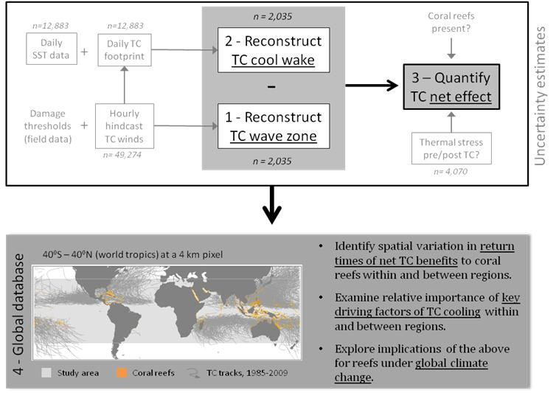
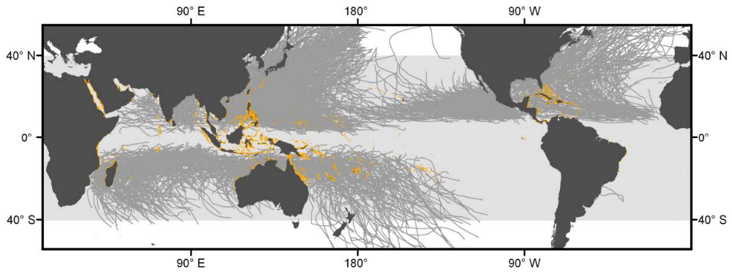
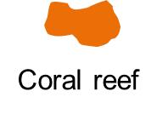
Does this happen enough to be useful?
1985-2011
TC track

Slide 10
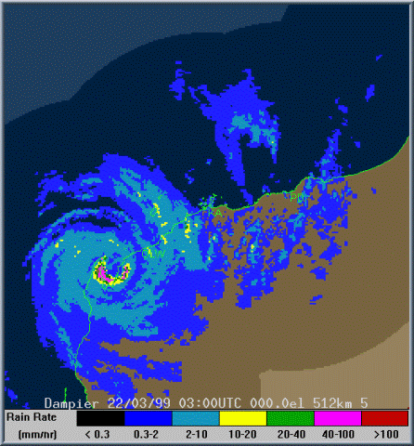
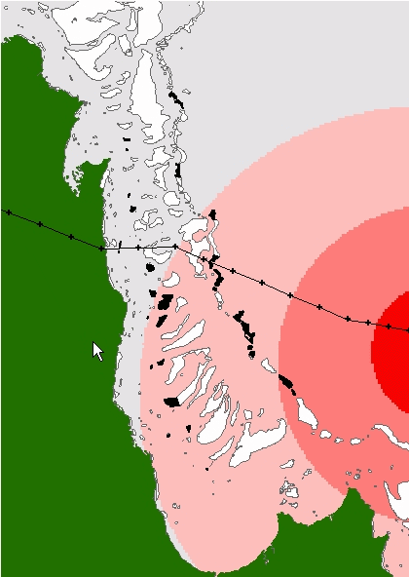

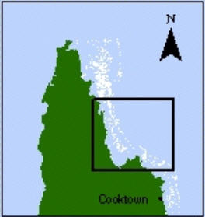
1. Reconstruct TC wave zone…
Cyclone Ingrid,
March 2005
Hourly 10 min surface winds
1. Input data
Category 0
Eye position
Central pressure
Translation speed
Direction
Category 1
Category 2
Category 3
2. Meteorological equations
Wind speed = f(input data, distance from eye, scaling constant)
Cyclone eye
Survey reefs
Mainland
3. Wind speed / direction grids
Puotinen 2007 Int J GIS

Slide 11
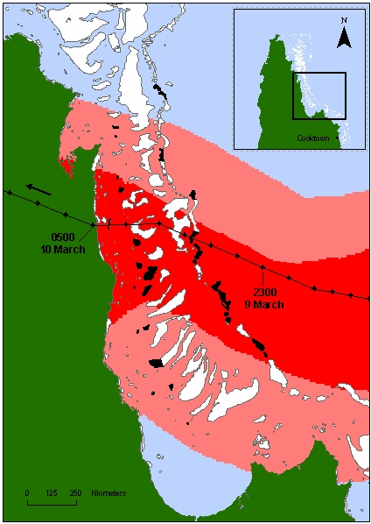
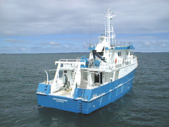
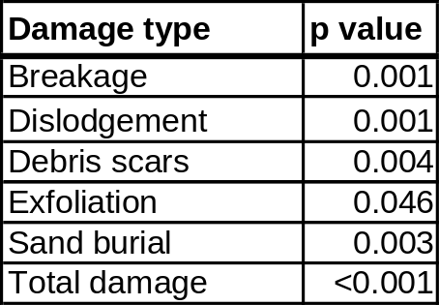
1. Reconstruct TC wave damage zone...
TC wind zone
Cyclone Ingrid, ‘05
Max winds vs field survey data (n=82)
Damage thresholds
CATASTROPHIC DAMAGE =
Max winds > 40 m/s (outer reefs)
Max winds > 33 m/s AND Gales > 12 hours (inner reefs)
ANY DAMAGE =
Max winds > 28 m/s (all reefs)
Fabricius et al 2008 LM&O
Notes:
Tropical cyclones, such as Justin [hit animation], which passed through the Great Barrier Reef in 1997, and Ivor, [hit animation] which passed through in 1990 generate unusually large waves that can cause signficant structural damage to coral reef communities...

Slide 12
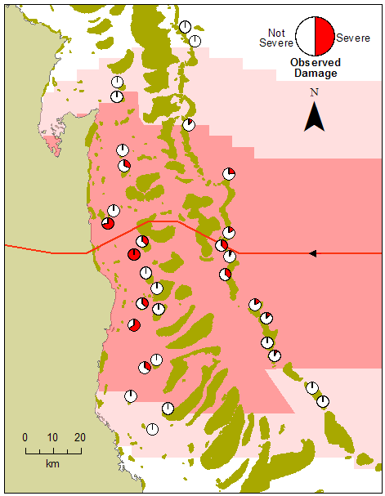
A ‘worst case scenario’ approach…
AIM = define zone beyond which no damage occurs.
Actual damage will still be patchy within this zone (overprediction).
TC Ingrid damage zone versus field data.

Slide 13
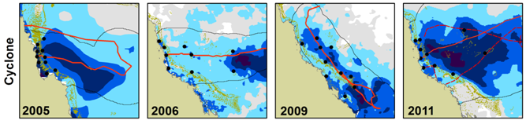


2. Reconstruct TC cool wake...
Pre-cyclone Base SST
Post-cyclone SST
preSST = mean(SST_{t-14},…, SST_{t-1})
postSST = mean(SST_{t+3}, …, SST_{t+16})
…
…
t-14
t-2
t-1
t
t+3
t+4
t+16
1. Where postSST – preSST > 1⁰C
TC
2. Within TC ‘footprint’ (gale wind zone)
Ingrid Larry Hamish Yasi (Anthony)
Ingrid 2005 Larry 2006 Hamish 2009 Yasi / Anthony 2011

Slide 14

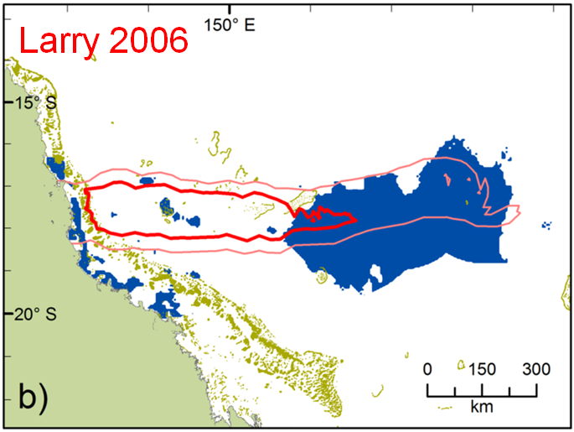
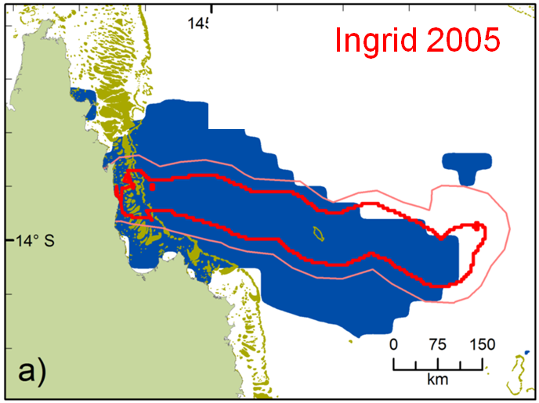
3. Quantify TC net effect…
NEI = Total reef area cool wake – Total reef area wave zone X 100
Total reef area cool wake
- NEI
NEI = -143
+ NEI
NEI = +82
More reefs damaged than cooled
21.9% of GBR TCs
More reefs cooled than damaged
46.3% of GBR TCs

Slide 15
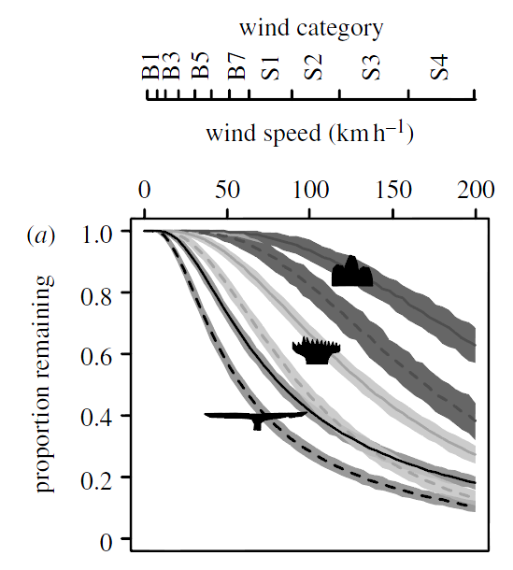
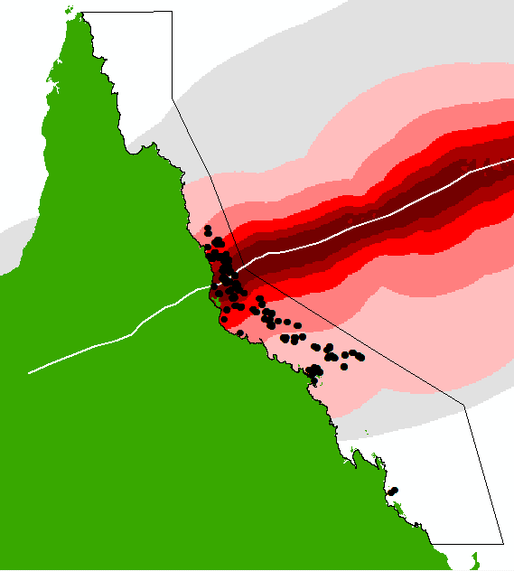

Future work…
Reduce false positives in TC wave damage zone by considering structural vulnerability –
Collaboration with Macquarie Uni
GBRMPA Yasi survey, n=904
Madin et al Biology Letters 2008
Improve damage thresholds by assessing relationships with more field data–
Collaboration with GBRMPA
Survey
sites

Slide 16




Acknowledgements…
On-going funding, equipment, technical support (MP, AC)
On-going technical support (MP)
PhD funding, equipment and support (MP)
TC Ingrid survey, PhD funding (MP)
PhD funding (MP)
PhD funding (MP)

